Slide 1
Read Write Inc. Phonics

Slide 2
Aims
Introduction to daily Read, Write Inc. Phonics lessons
Show how children learn to read with phonics
How to say the sounds (and blend them together)

Slide 3
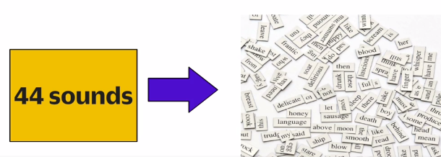
Phonics
A method of teaching children to read and write the English Language. It teaches children that the sounds of English are represented by letters or groups of letters. We use 44 sounds to make all the words in the English language.

Slide 4
Organisation
RWI phonics has a very structured / systematic approach (one way to read and spell the English sounds)
It is delivered to groups of children daily (20 minute sessions)
Literacy Lessons taught throughout the week
Spelling, Punctuation and Grammar lessons
Reading Comprehension lessons
Writing lessons

Slide 5
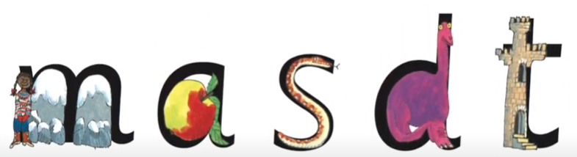
Learning Phonics (synthetic)
Hook to learn the sounds – pictures are in the same shape as the letter
Synthetic phonics is a way of teaching reading. The letter 'm' sounds like 'mmmm' when we say it.

Slide 6
Speed Sounds lessons Set 1
Children learn a sound a day
They are taught to:
Hear and say the sound
Read the sound
Write the sound

Slide 7

My Turn – Your Turn
Listen to and say the sound ‘mmmm’
Read the sound using the picture
Write the sound using the rhyme
Maisie, mountain, mountain

Slide 8

Word Time! Fred Talk
After the first 5 sounds are taught
m, a, s, d and t
The children are introduced to a character called Fred.
These 5 sounds can be blended for reading to make simple CVC (consonant – vowel – consonant) words.

Slide 9
Saying the sounds
The sounds must be very pure and distinct so children can sound-blend.
c-a-t = cat, ch-i-p = chip, l-igh-t = light
Try to aviod cuh-a-tuh, chuh-i-puh, luh-igh-tuh
https://www.oxfordowl.co.uk/for-home/reading-owl/find-a-book/read-write-inc-phonics--1/phonics-pure-sounds-video

Slide 10
Perfect Partner Practice
Practice saying all the stretchy consonant sounds.
f, l, m, n, r, s, v, z, sh, th, ng nk
Practice saying all the bouncy consonant sounds.
b, c k, d, g, h, j, p, qu, t, w, x, y, ch
Practice saying the bouncy vowel sounds.
a, e, i, o, u
Practice saying the stretchy vowel sounds.
ay, ee, igh, ow (blow), oo, oo (look), ar, or, air, ir, ou, oy

Slide 11
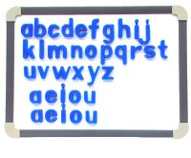
Word Time! magnetic letters
Children know m, a, s, d and t
mad sad dad mat
sat sam
dat das tas
m, a, s, d and t

Slide 12

Word Time! Fred Fingers
Children know m, a, s, d and t
Blend with talk
Blending with cards
Blending with magnetic letters
Fred Fingers
Fred Talk = reading Fred Fingers = segmenting for spelling

Slide 13
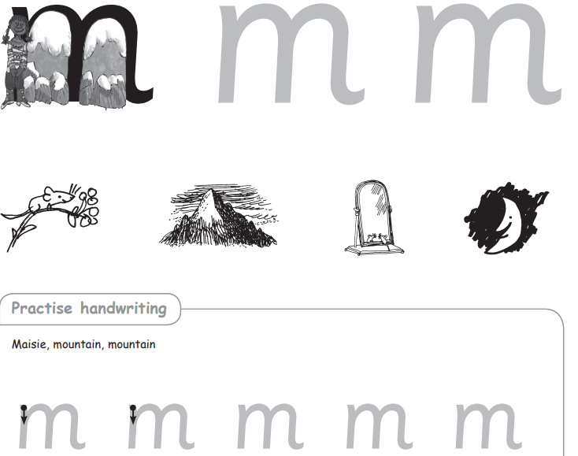

Sound Books, Green Words & Sound Blending books
As soon as the children have been taught the first few sounds they take them home in a red sound book.

Slide 14
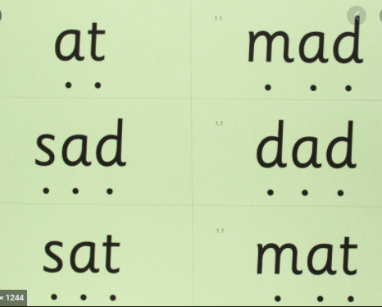
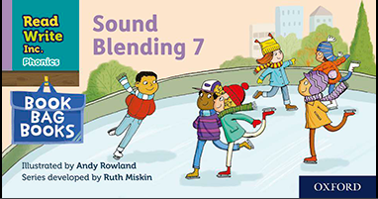
Green words and Sound Blending
After they have been taught the first 5 sounds, they may take home Green Word cards to sound-blend or Sound Blending books.
These are an important bridge between Speed Sounds 1, blending and reading Ditty Books.

Slide 15

Assessment and Reading Books
The RWI scheme includes storybooks linked to each stage of phonics and provide the children with an opportunity to read at their pace and at their own decoding ability. The books do not require them to use other strategies to work out words.
Children will bring home carefully matched RWI books to read with you. The books only include sounds that they have already learnt and with which they are fully secure. Please explain the story to your child using the ‘Introduction’ and follow the reading activities (advice is given on the inside cover and first page of each book):

Slide 16
Reading at home
Practise reading the Speed Sounds
Read the Green words (words you can sound out), Red words (tricky words)
Listen to the introduction – language comprehension
Discuss the vocabulary check
Read the story (can be ‘My Turn/ Your Turn – child reads a line/page – adult reads a line/page)
Re-read the story and discuss the ‘questions to talk about’
Practise reading the Speed Words

Slide 17
Reading at home
It is expected that children should read and re-read books accurately. Therefore it is recommended that your child reads the story aloud three times, once to decode the words, the second time so you can ensure they fully comprehend, and thirdly to discuss the story in greater depth. This strategy will scaffold their reading knowledge and development and ensure they become a confident and secure reader.
Reading books will be changed weekly and your child will have two or three books each week. Some books might be challenging and your child might rely heavily on sounding out and blending (Fred Talk) at first, but with lots of practise and help from home they will move through the programme confidently.

Slide 18

Early Reading - Ditties
The RWI books are carefully matched to the sounds they have been taught.
Once the children can read and blend all the Set 1 sounds into words e.g. cat, hot, big, they then read the Red Ditty books.
Extra Ditty sheets might be used as a bridge between Red Ditties and the Green books.

Slide 19
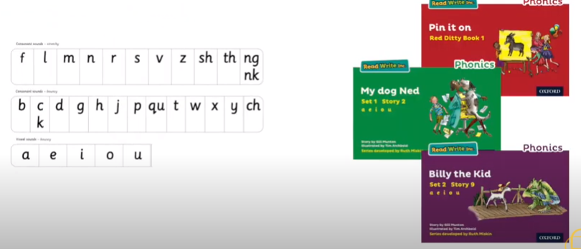
Early Reading
The RWI scheme includes storybooks linked to each stage of phonics and provide the children with an opportunity to read at their pace and at their own decoding ability.
If children know these sounds they
can read these books.

Slide 20
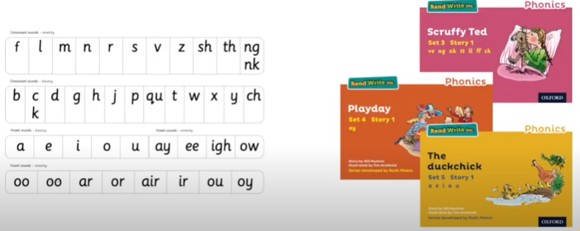
Early Reading

Slide 21
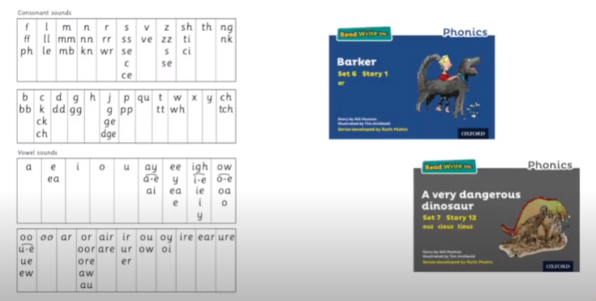
Reading

Slide 22


Red Words
Red words are used in the Ditties and Storybooks.
They are common words with an uncommon spelling e.g. ‘said’ ‘would’ ‘brought’
They are displayed on a Red Word Wall.
They contain graphemes that are not on the RWI chart,
therefore, they cannot be Fred Talked (sound blended).
Red ‘for a while’ Words
These include grapheme that have not been taught by the time they are needed. As soon as the grapheme has been taught, they turn into Green Words!

Slide 23
Assessment
Every eight weeks children are assessed using the RWI sound assessment. Once assessed, children are organised into their phonics groups.
The children are tracked, reassessed and regrouped.

Slide 24

Year 1 & Year 2 Phonics Screening Check
Children in Year 1 throughout the country will be taking part in a phonics screening check during the same week in June.
Children in Year 2 will take the check during the week beginning 29th November
The check is designed to confirm whether individual children have learnt blending to an appropriate standard.
The screening check contains 40 words divided into two sections of 20 words.
Both sections contain a mixture of real words and ‘alien’ words.

Slide 25
Phonics Screening Materials
https://www.youtube.com/watch?v=LbKGLJPp6ww
Phonics screening check (Year 1) | Oxford Owl
School website for green word and alien word sheets

Slide 26
How can I help my child at home?
If your child is struggling to decode a word, help them by encouraging them to say each sound in the word from left to right.
Blend the sounds by pointing to each letter. Next move your finger under the whole word as you say it.
Discuss the meaning of words.

Slide 27
Spelling
When the children have reached the appropriate stage in the phonics programme, they move on to spelling lessons.
The children will work through a range of spelling units each of which focus on a spelling pattern.

Slide 28
Questions
Any questions?

