Slide 1

CLAYPOLE CE Primary School
Relationships AND Sex Education

Slide 2
New Guidance
20 years since the last review of the curriculum- the world (and how we interact with each other) has changed
New- Relationships Education in Primary Schools
Previous recommendations for teaching Personal, Social, Health Education, are now part of the National Curriculum.
Sex Education in Primary Schools remains optional, though in Year 5 & 6 the science curriculum form part of what might be considered as sex education- puberty and reproduction.

Slide 3
Science Curriculum
As part of the Science curriculum we teach the following statutory objectives that build understanding about growth and reproduction:
Year One
Identify, name, draw and label the basic parts of the human body and say which part of the body is associated with each sense.
Year Two
Notice that animals, including humans, have offspring which grow into adults they should not be expected to understand how reproduction occurs.
Year Five and Year Six
Describe the life process of reproduction in some plants and animals. They should learn about the changes experienced in puberty

Slide 4
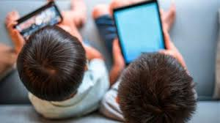



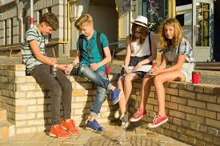

Where and how did you learn about sex and relationships?
For young people, their learning comes from…
TV
Internet
Mobile phones
School
Friends & Older Siblings
Parents & Carers

Slide 5
Why is Relationships and
Sex Education important?
    Entitlement
    Puberty is starting earlier- for some children by age 9
    Unwanted conceptions
    Sexually transmitted infections
    Safeguarding:
      Grooming
      Child Sexual Exploitation
      Abuse
      Sexting
      Online pornography

Slide 6
What is effective
Relationships &Sex Education (SRE)?
    Age appropriate
    Based on needs of pupil (see later slides)
    Progressive
    Inclusive
    Delivered by trained staff in a safe environment
    Prepares children adequately for puberty in a timely way
    Prepares children for adult life
    Promotes positive relationships

Slide 7
Does it work? What’s the evidence?
  Those receiving good quality RSE are more likely to:
    Delay their first sexual experience
    Use condoms for contraception
    Have fewer sexual partners
    Kirby 2007

Slide 8
Ofsted review of existing RSE nationally
  Required improved in over a third of schools was not systematic enough
  Children were not adequately prepared for puberty
  In Primary Schools, too much emphasis was placed on friendships and relationships

Slide 9
Your rights as a parent:
  To be informed of the RSE curriculum and policy
  To be consulted about changes to these
  To withdraw your child from Sex education lessons (that are outside of/ additional to the Science National Curriculum

Slide 10
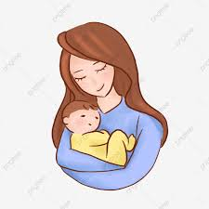
Finding out from children about what they already know/ need to know about Relationships and Sex :
What do they need to know now? (What they view as age appropriate)
What do they need to know at the age of 13?
In addition they were asked:
‘Tell me about this picture….’

Slide 11
What do children say?
What children feel they need to know about now:
Year 2:
Mainly about rules and keeping safe
Year 4:
Body changes- growing bigger, voice changes, marriage and dating (though dating wouldn’t start until secondary school)
Year 6:
Hormones, body changes, relationships with family and friends, gender and sexuality; gender stereotypes

Slide 12
What do children say they needed to know sooner?
    Year 2:
    Internet safety
    Stranger danger
    Knives
    Year 4:
    Bullying
    Internet safety
    Having babies
    Periods and hair growing under armpits
    Year 6:
    How not to have a baby

Slide 13

Where did children think the
baby had come from?
Year 2: It has come from Scotland It was found on a doorstep A shop A seed from daddy A seed from a plant God Staying in bed Telepathy | Year 4: You eat a seed God A man and a girl do a thingamajig I’m not saying! Sperm like a tadpole Confusion about how a woman could be pregnant without a man | Year 6: Lots of giggling … more giggling! Sperm, Testicles Womb Egg

Slide 14
How does the baby get out?
Year 2: Push it out Belly button Out of your private bits The pelvis Hospital | Year 4: Their bottom Their tummy Go to hospital and sit in a chair and push It comes out of their tummy They have to cut the belly open | Year 6: You know you are in labour because water comes out Vagina If something is wrong cut open her belly

Slide 15
Other observations:
  Giggles/ embarrassment (Year 6)
  Struggle to name body parts
  Some talked to parents/ carers
  Use of gay seen as an insult
  Gender stereotypes
  Wanted more RSE than they had had (Y6)
  Wanted Teachers to deliver the learning (Y6)

Slide 16
Recommendations for Changes/ Schools:
Introduce children to the correct scientific terms to describe body parts in Key Stage 1
Challenge the use of ‘gay’ as an insult and include work around the makeup of different families
Explore/ challenge gender roles/ sterotypes
Begin to explore puberty changes by the age of 8/9
Deliver RSE in a progressive way across the school
Ensure that children in Year 5 and 6 receive RSE input around puberty so that they are prepared as soon as possible for the onset of puberty
For some sessions on Sex Education consider single gender sessions

Slide 17
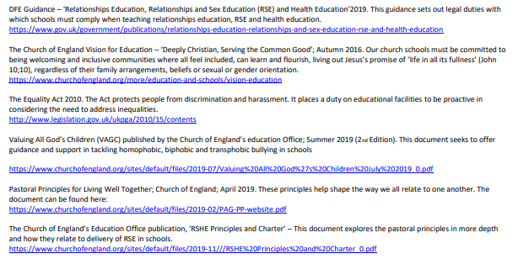

Slide 18
Summary
Parents have the right to withdraw children from Sex Education lessons at Primary School that go beyond the content in the Science National Curriculum.
Topics covered related and linked to the Science Curriculum are statutory and not optional to teach. This is as follows:
    In Key Stage 1, children learn that animals, including humans, have offspring that grow into adults. They should be introduced to the concepts of reproduction and growth but not how reproduction occurs.
    In Upper Key Stage 2 (Year 5/6), children are taught about the life cycles of humans and animals, including reproduction. They also learn about the change that happen in humans from birth to old age. This includes learning about what happens in puberty.
School’s have the right and obligation to teach RSE topic to prepare children for life when they leave school.
The curriculum on Relationships and Sex Education should complement, and be supported by, the school’s wider policies on Behaviour, bullying and safeguarding (PSEH; E-Safety, Relationships etc).

Slide 19
Next Steps:
Please reach out to us if you have any concerns or queries
Curriculum maps will be available on our website
Families will be kept updated

