Slide 1
Read Write Inc. Phonics

Slide 2
Aims
Introduction to daily Read, Write Inc. Phonics lessons
Show how children learn to read with phonics
How to say the sounds (and blend them together)

Slide 3
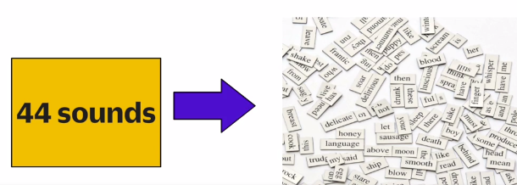
Phonics
A method of teaching children to read and write the English Language. It teaches children that the sounds of English are represented by letters or groups of letters. We use 44 sounds to make all the words in the English language.

Slide 4
Organisation
RWI phonics has a very structured / systematic approach (one way to read and spell the English sounds)
It is delivered to groups of children daily (20 minute sessions)

Slide 5
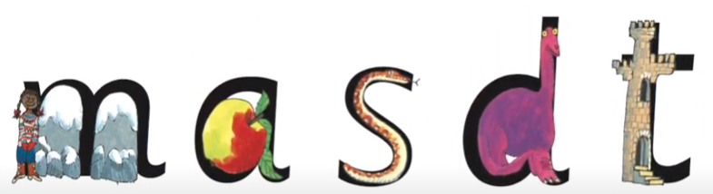
Learning Phonics (synthetic)
Hook to learn the sounds – pictures are in the same shape as the letter
Synthetic phonics is a way of teaching reading. The letter 'm' sounds like 'mmmm' when we say it.

Slide 6

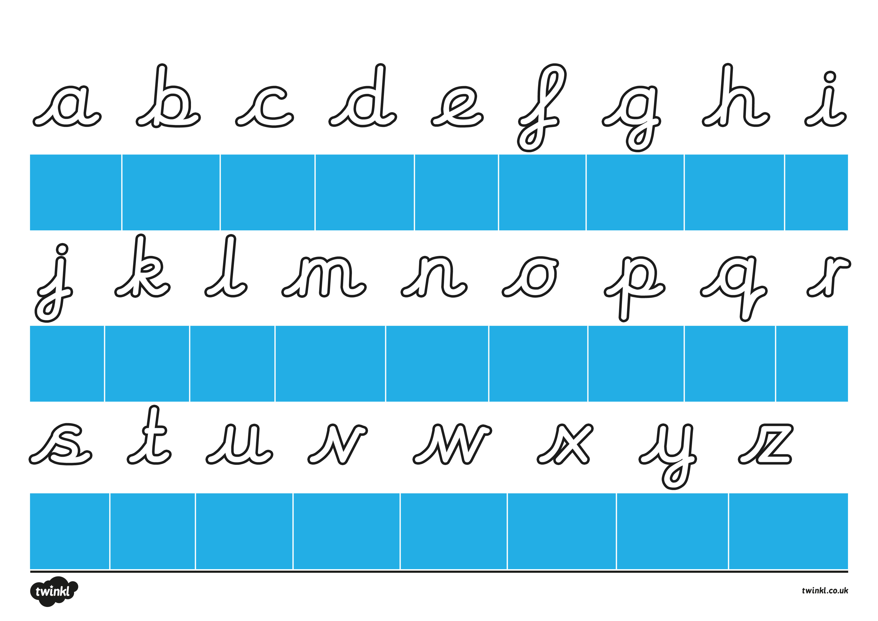
My Turn – Your Turn
Listen to and say the sound ‘mmmm’
Read the sound using the picture
Write the sound using pre-cursive rhyme
Start on the line, whoosh in, Maisie, mountain, mountain and flick.

Slide 7
Speed Sounds lessons Set 1
Children learn a sound a day
Hear and say ‘m’
Read ‘m’
Write ‘m’

Slide 8

Word Time! Fred Talk
After the first 5 sounds are taught
m, a, s, d and t
The children are introduced to a character called Fred.
These 5 sounds can be blended for reading to make simple CVC (consonant – vowel – consonant) words.

Slide 9
Saying the sounds
The sounds must be very pure and distinct so children can sound-blend.
c-a-t = cat, ch-i-p = chip, l-igh-t = light
Try to aviod cuh-a-tuh, chuh-i-puh, luh-igh-tuh
https://www.oxfordowl.co.uk/for-home/reading-owl/find-a-book/read-write-inc-phonics--1/phonics-pure-sounds-video

Slide 10
Perfect Partner Practice
Practice saying all the stretchy consonant sounds.
f, l, m, n, r, s, v, z, sh, th, ng nk
Practice saying all the bouncy consonant sounds.
b, c k, d, g, h, j, p, qu, t, w, x, y, ch
Practice saying the bouncy vowel sounds.
a, e, i, o, u
Practice saying the stretchy vowel sounds.
ay, ee, igh, ow (blow), oo, oo (look), ar, or, air, ir, ou, oy

Slide 11
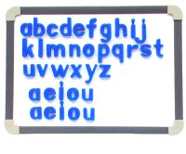
Word Time! magnetic letters
Children know m, a, s, d and t
mad sad dad mat
sat sam
dat das tas
m, a, s, d and t

Slide 12

Word Time! Fred Fingers
Children know m, a, s, d and t
Blend with talk
Blending with cards
Blending with magnetic letters
Fred Fingers
Fred Talk = reading Fred Fingers = segmenting for spelling

Slide 13
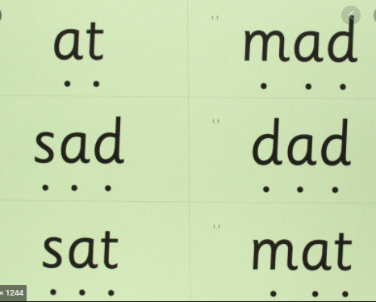
Sound Books & Green Words
As soon as the children have been taught the first 5 sounds, they take home Green Word cards to sound-blend.
Children who are still learning Set 1 sounds and learning to blend are given Green Word cards to take home to read.
These are an important bridge between Speed Sounds 1, blending and reading Ditty Books.

Slide 14

Early Reading - Ditties
Once the children have been taught Set 1 Sounds and blending they can take RWI Ditty books home. The books are carefully matched to the sounds they have been taught.

Slide 15
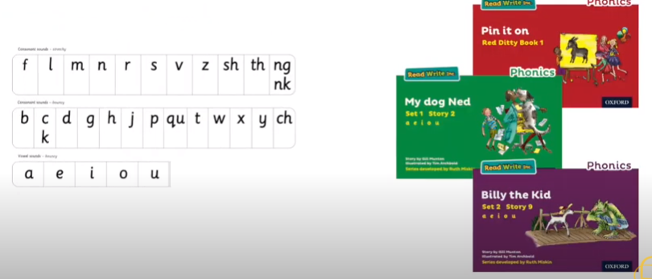
Early Reading
The RWI scheme includes storybooks linked to each stage of phonics and provide the children with an opportunity to read at their pace and at their own decoding ability.
If children know these sounds they
can read these books.

Slide 16
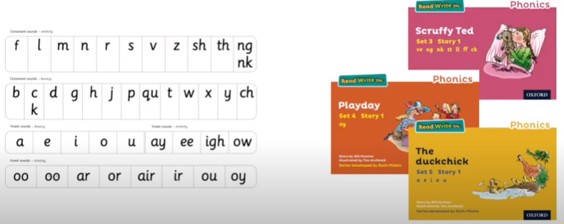
Early Reading

Slide 17
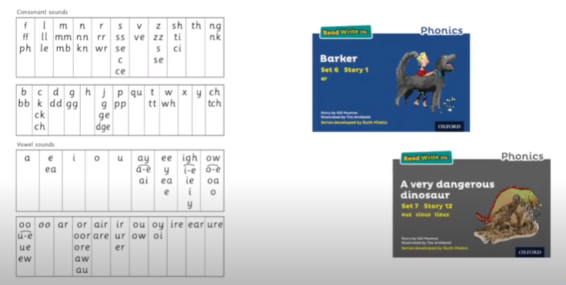
Reading

Slide 18


Red Words
Red words are used in the Ditties and Storybooks.
They are common words with an uncommon spelling e.g. ‘said’ ‘would’ ‘brought’
They are displayed on a Red Word Wall.
They contain graphemes that are not on the chart.
The grey letters how you the ‘grotty’ grapheme.
Red ‘for a while’ Words
These include grapheme that have not been taught by the time they are needed. As soon as the grapheme has been taught, they turn into Green Words!

Slide 19
Assessment
Every eight weeks children are assessed using the RWI sound assessment. Once assessed, children are organised into their phonics groups.
The children are tracked, reassessed and regrouped.

Slide 20

Year 1 Phonics Screening Check
Children in Year 1 throughout the country will be taking part in a phonics screening check during the same week in June.
The check is designed to confirm whether individual children have learnt blending to an appropriate standard.
The screening check contains 40 words divided into two sections of 20 words.
Both sections contain a mixture of real words and ‘alien’ words.

Slide 21
Phonics Screening Materials
www.education.gov.uk/schools/teachingandlearning/assessment/keystage1/a00200415/year-1-phonics-screening-check-materials
https://www.youtube.com/watch?v=LbKGLJPp6ww

